Slide 1

Integrated System for Fake News and Deepfake Video Detection
School of Computer Science and Engineering
Department of Computer Science and Engineering
Submitted By :
Abhishek Singh
Reg.No. 2427030569
Supervised By :
Dr. Neetu Gupta

Slide 2
Outline
Introduction
Literature Review
Problem Statement
Proposed Solution
Objectives
Results

Slide 3
Introduction :-
In today’s digital era, the rapid spread of misinformation and AI-generated fake media poses serious social, political, and ethical challenges.
Fake news manipulates public opinion by spreading false information through online platforms.
Deepfake videos, created using advanced AI techniques, can convincingly alter visual and audio content, making it difficult to distinguish real from fake and resulting privacy breaches.
The integration of Machine Learning (ML), Natural Language Processing (NLP) can help detect and prevent the circulation of such deceptive content.
This project proposes an integrated system capable of detecting both fake textual news and deepfake videos, ensuring a more reliable and trustworthy digital ecosystem.

Slide 4
Literature Review :-
Main approaches and technologies used :
Fake News Detection:
• Textual methods: classical NLP (feature engineering + ML) → transformer-based classifiers are now standard for article/headline classification.
• Multimodal fusion: approaches that combine text + images (cross-modal attention, contrastive learning) improve accuracy over unimodal models. Example frameworks explicitly model cross-modal alignment (contrastive / optimal transport methods).
• Social/propagation signals: network features (who shared, how fast, propagation tree) and user metadata are used to detect misinformation early.

Slide 5
2. Deepfake Video Detection :
• Frame-level / spatial detectors: CNNs and Vision Transformers detect synthetic artifacts (blending, inconsistent textures).
• Temporal and audio cues: Models that examine temporal inconsistencies (head/eye motion , eye blinking frequently) and audio/video correspondence perform better for video deepfakes.
• Physiological signals: Recent work exploits subtle biological signals (e.g., heartbeat / blood-flow changes visible in skin reflectance) as a robust cue against face swapping.
Some prior models /major works are:
1. FaceForensics++ (Rössler et al., 2019): Benchmark dataset + Xception-based baselines for image/video forgery detection; became a standard evaluation suite.
2. FakeCatcher (Ciftci et al., 2020) : Uses physiological/biological signals (subtle pulse changes in skin) to detect synthetic portrait videos; robust across generators.

Slide 6
Problem Statement :-
• There is a lack of an integrated, robust, and explainable system capable of detecting both textual fake news and deepfake video content in real time across multiple online platforms.

Slide 7
Objectives :-
• To design a user-friendly web interface or dashboard that enables real-time detection, visualization, and report generation for detected fake or manipulated content.
• To develop an integrated detection framework that can analyze and identify both fake textual news and deepfake video content within a unified system.
• To enhance model robustness and generalization so the system can handle real-world, noisy, and cross-platform misinformation effectively.

Slide 8
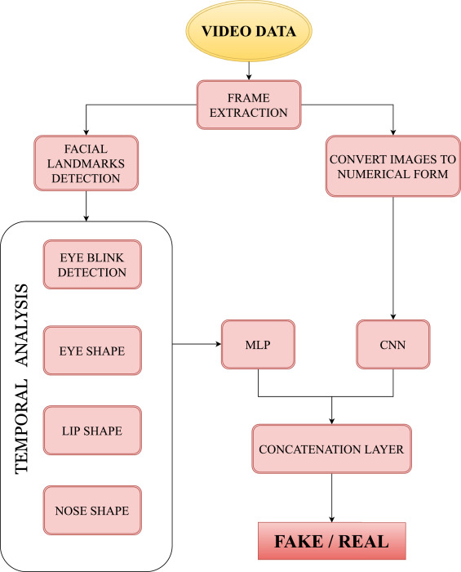
Proposed Solution :-
Step 1: Data Collection & Preprocessing.
Step 2: Feature Extraction : Using Transformers like
BERT/RoberTA and tokenizers for texts , CNN for video ,
MFCC for Audio and lip-sync mismatch.
Step 3: Deepfake Detection Module.
Step 4: Fake News Detection Module.
Step 5: Multimodal Fusion Layer : For combining audio
Text , video models for overall authenticity score.

Slide 9
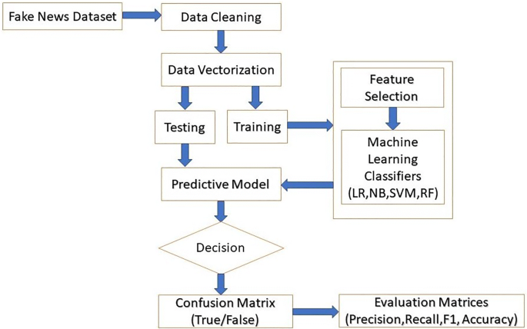
Step 6: Explainability Module (XAI): Provide visual/textual explanations to users and build their trust.
Step 7: User interface and Real Time System.
Step 8: Evaluation and Optimization.

Slide 10
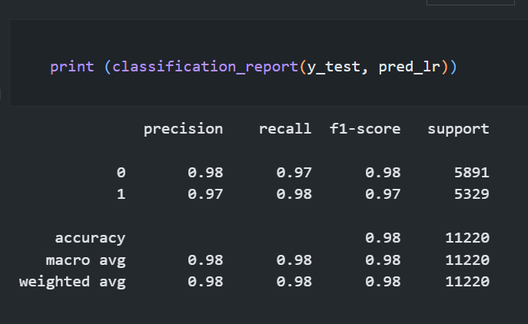
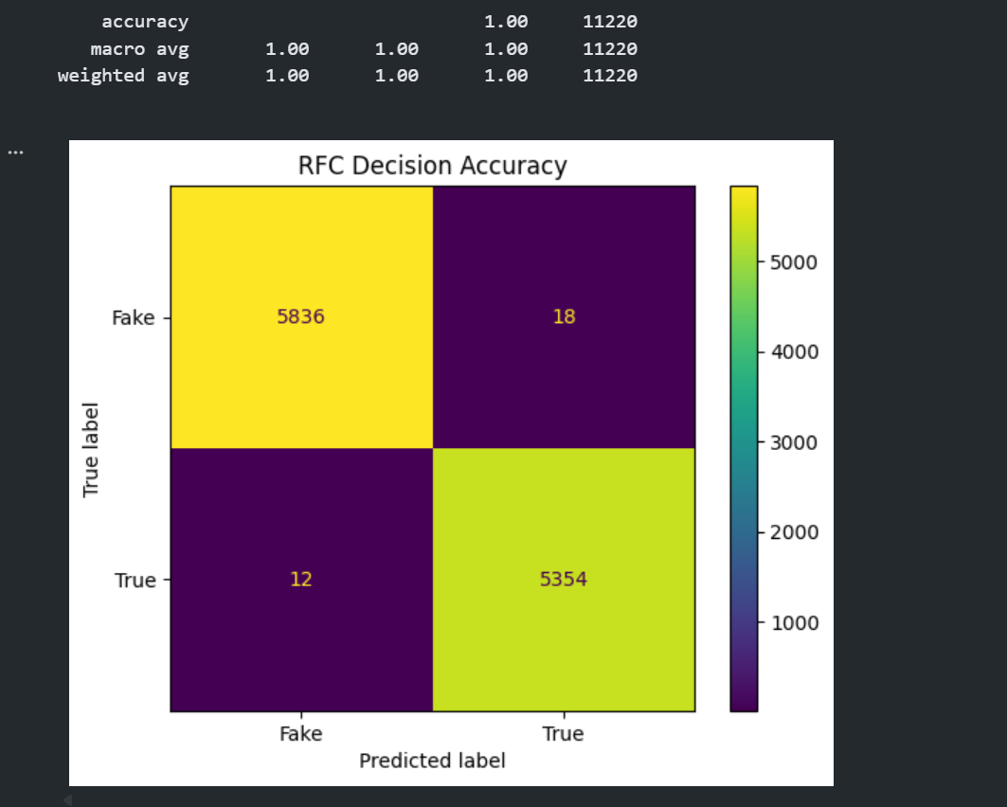
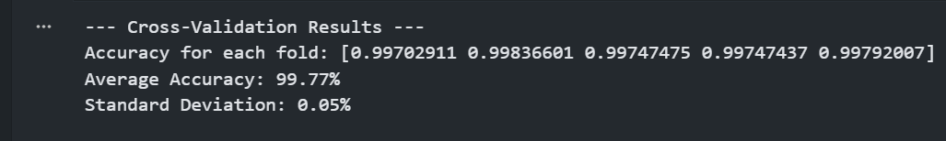
Result :-

Slide 11
Current Outcomes
Built an NLP-based ML model to classify news as Fake or Real.
Performed text preprocessing and TF-IDF feature extraction.
Trained and evaluated supervised learning model.
Achieved high classification accuracy (96%).
Evaluated using Accuracy, Precision, Recall & F1-Score.
Upcoming Work
Improve model using advanced algorithms (SVM) & BERT transformers.
Save and deploy model as a web application
Build frontend interface for real-time predictions
Integrate database for storing prediction history

Slide 12
References :-
• Kaliyar, R. K., Goswami, A., & Narang, P. (2021). FakeBERT
• Kaggle Datasets : Fake News and Deepfake Video Datasets.
• D. Lucky, “Deepfake Detection,” ResearchGate, 2021.
• D. Güera and E. J. Delp, “Deepfake video detection using recurrent neural networks,” IEEE International Conference on Advanced Video and Signal Based Surveillance (AVSS), pp. 1–6, 2018.
DOI: 10.1109/AVSS.2018.8639163

Slide 13
Thank You

